Slide 1
Recovery

Slide 2
Why recovery is needed:
Transaction failure :
Logical errors: transaction cannot complete due to some internal error condition
System errors: the database system must terminate an active transaction due to an error condition (e.g., deadlock)
2. System crash: a power failure or other hardware or software failure
causes the system to crash.
Fail-stop assumption: non-volatile storage contents are assumed to not be corrupted by system crash
Database systems have numerous integrity checks to prevent corruption of disk data
Disk failure: a head crash or similar disk failure destroys all or
part of disk storage
Destruction is assumed to be detectable: disk drives use checksums to detect failures

Slide 3
Recovery Schemes
Recovery schemes are techniques to ensure database consistency and transaction atomicity and durability despite failures such as transaction failures, system crashes, disk failures.
Recovery algorithms have two parts
Actions taken during normal transaction processing to ensure enough information exists to recover from failures
Actions taken after a failure to recover the database contents to a state that ensures atomicity, consistency and durability

Slide 4
Recovery and Atomicity
Two approaches are possible:
log-based recovery, and
shadow-paging

Slide 5
The log files role in rollbacks and failure recovery
A log file maintains a record of all changes to the database, including the ID of the perpetrating transaction, a before-image of each modified object.
The log file enables recovery from a failure that loses the memory buffer’s contents but doesn’t corrupt the database.

Slide 6
Log-Based Recovery
A log is kept on stable storage.
The log is a sequence of log records, and maintains a record of update activities on the database.
When transaction T_{i} starts, it registers itself by writing a <T_{i} start>log record
Before T_{i} executes write(X), a log record <T_{i}, X, V₁, V₂> is written, where V₁ is the value of X before the write, and V₂ is the value to be written to X.
Log record notes that T_{i} has performed a write on data item X. X had value V₁ before the write, and will have value V₂ after the write.
When T_{i} finishes it last statement, the log record <T_{i} commit> is written.
For writing the actual records
Deferred database modification
Immediate database modification

Slide 7
Deferred Database Modification(No-undo/redo)
The deferred database modification scheme records all modifications to the log, and defers writes to after partial commit.
Transaction starts by writing <T_{i} start> record to log.
A write(X) operation results in a log record <T_{i}, X, V> being written, where V is the new value for X (old value is not needed).
The write is not performed on X at this time, but is deferred.
When T_{i} partially commits, <T_{i} commit> is written to the log
After that, the log records are read and used to actually execute the previously deferred writes.

Slide 8
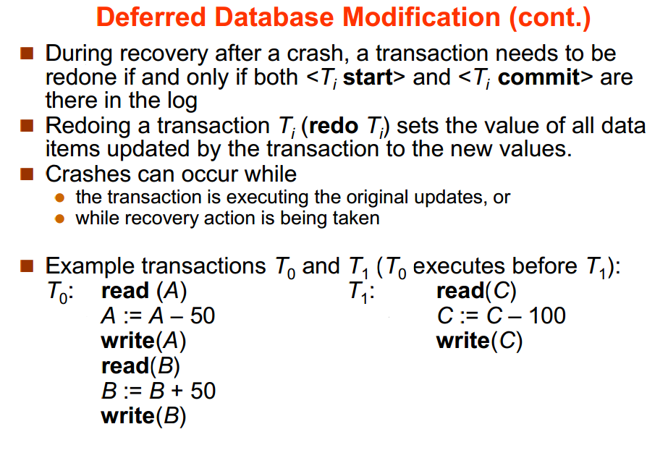
A=1000
B=2000
C=700

Slide 9
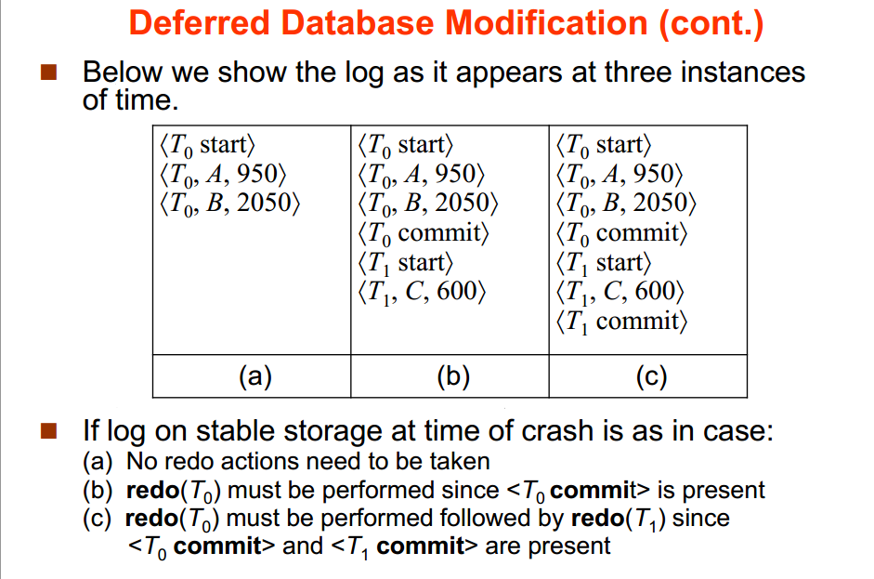

Slide 10
Immediate Database Modification(undo/redo)
Each log follows an actual database modification. That is, database is modified immediately after every operation.
since undoing may be needed, update logs must have both old value and new value
<T_{n}, X, V₁, V₂>

Slide 11
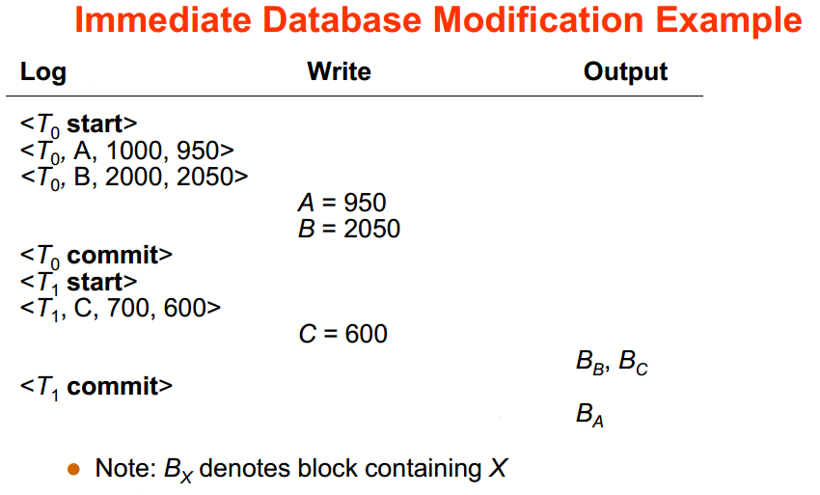

Slide 12
Immediate Database Modification (Cont.)
Recovery procedure has two operations instead of one:
undo(T_{i}) restores the value of all data items updated by T_{i} to their old values, going backwards from the last log record for T_{i}
redo(T_{i}) sets the value of all data items updated by T_{i} to the new values, going forward from the first log record for T_{i}
When recovering after failure:
Transaction T_{i} needs to be undone if the log contains the record <T_{i} start>, but does not contain the record <T_{i} commit>.
Transaction T_{i} needs to be redone if the log contains both the record <T_{i} start> and the record <T_{i} commit>.
Undo operations are performed first, then redo operations.

Slide 13
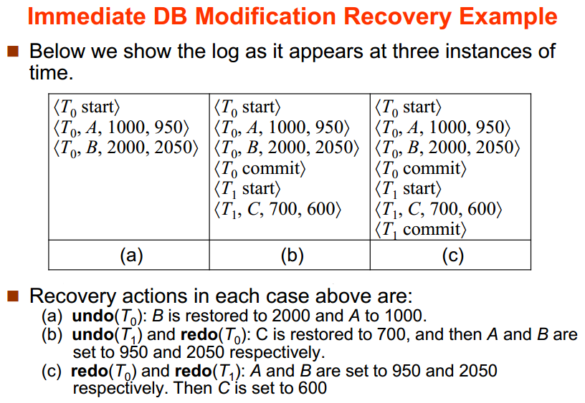

Slide 14
Checkpoints
Checkpoint is a mechanism where all the previous logs are removed from the system and stored permanently in storage disk.
Checkpoint declares a point before which the DBMS was in consistent state and all the transactions were committed.

Slide 15
Checkpoints
During recovery we need to consider only the most recent transaction Ti that started before the checkpoint, and transactions that started after Ti.
Scan backwards from end of log to find the most recent <checkpoint> record
Continue scanning backwards till a record <Ti start> is found.
Need only consider the part of log following above start record. Earlier part of log can be ignored during recovery, and can be erased whenever desired.
For all transactions (starting from Ti or later) with no <Ti commit>, execute undo(Ti). (Done only in case of immediate modification.)
Scanning forward in the log, for all transactions starting from Ti or later with a <Ti commit>, execute redo(Ti)

Slide 16
